Slide 1

Techista
Pill Detection Model using TensorFlow
for People with Visual Impairments

Slide 2
INTRODUCTION
Visual impairments, such as blindness or weak eyesight, pose significant challenges in identifying medications for individuals. This presentation focuses on utilizing TensorFlow, a powerful machine learning framework, to develop a pill detection model. The aim is to assist people with visual impairments in accurately identifying and differentiating various pills for improved medication management and safety.

Slide 3

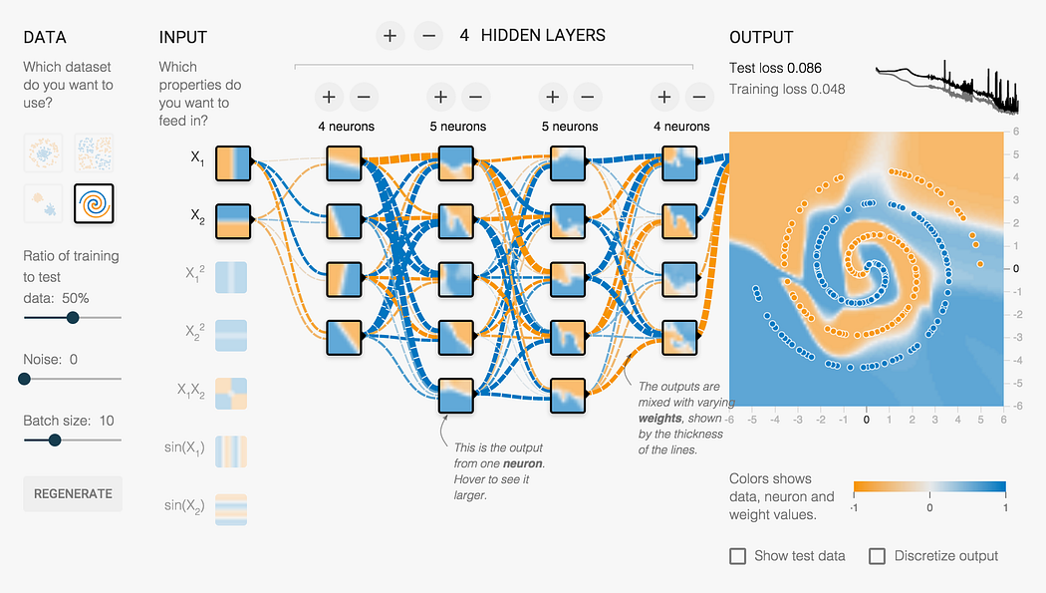
TensorFlow Overview:
TensorFlow is an open-source machine learning framework developed by Google. It provides a comprehensive set of tools and libraries for building and training deep learning models. Leveraging TensorFlow, we can develop a robust pill detection model capable of accurately classifying different types of pills based on their visual features.

Slide 4



Dataset Collection
Data
Set
To train the pill detection model, a diverse and representative dataset of pill images is required. We collected a
large-scale dataset comprising thousands of pill images with corresponding labels. This dataset ensures the model's ability to generalize and accurately identify various pill types.
Data
Set
Data
Set

Slide 5




Model Architecture
The pill detection model is built using a deep learning architecture. Convolutional Neural Networks (CNNs) form the backbone of the model, enabling it to learn and recognize distinctive visual features of pills. The model consists of multiple layers, including convolutional layers, pooling layers, and fully connected layers, culminating in a classification layer for pill recognition.
01
02
03
04

Slide 6
Training Process
During the training phase, the pill detection model learns to extract relevant visual features from the pill images and associate them with corresponding labels. Training involves feeding the dataset through the model, optimizing its parameters using backpropagation and gradient descent algorithms. The goal is to minimize classification errors and improve the model's accuracy.

Slide 7
Evaluation and Validation
After training, the pill detection model undergoes evaluation and validation. The model is tested on a separate dataset to assess its performance, including metrics such as accuracy, precision, recall, and F1-score. Rigorous validation ensures the model's reliability and effectiveness in real-world scenarios.

Slide 8




Evaluation Metrics
After training, the pill detection model is evaluated using various metrics to measure its performance. These metrics include:
ACCURACY
PRECISION
RECALL
F1-SCORE
It measures the overall correctness of the model's predictions, indicating the percentage of correctly classified pills.
It represents the proportion of correctly identified positive (pill) predictions out of all the positive predictions made by the model.
It signifies the proportion of correctly identified positive predictions out of all the actual positive instances present in the dataset.
It is a combination of precision and recall, providing a balanced measure of the model's performance by considering both false positives and false negatives.

Slide 9



Rigorous Validation:
S
I
P
SEPARATE DATASET
ITERATIVE IMPROVEMENT
PERFORMANCE ANALYSIS
The model is tested on a separate dataset that was not used during the training phase. This helps evaluate its ability to generalize to unseen pill images.
If the model's performance falls short, further iterations of training, fine-tuning, or hyperparameter optimization can be performed to enhance its accuracy and robustness.
The model's predictions on the validation dataset are compared against the ground truth labels. This analysis allows for the calculation of evaluation metrics such as accuracy, precision, recall, and F1-score.

Slide 10


Real-Time Pill Detection:
Once trained and validated, the pill detection model can be deployed to perform real-time pill detection using a camera or image input. The model analyzes the input image and provides accurate predictions, helping individuals with visual impairments identify and distinguish different pills in their medication routine.

Slide 11
Benefits:
Enhanced medication managment
The model assists inaccurate identification and differentiation of pills, contributing to improved medication management and adherence.
01
Safety and independence
Accessibility
The model promotes accessibility in healthcare, facilitating equal participation and inclusion for individuals with visual impairments.
02
03
By enabling individuals to verify their medications independently, the model enhances safety and empowers individuals with visual impairments.

Slide 12



Challenges and Future Directions
Dataset Diversity
While the pill detection model using TensorFlow offers significant advantages, certain challenges and future directions need consideration:
Real-World Scenarios
User Interface

Slide 13



Dataset Diversity
Dataset Diversity
Expanding the dataset to include a wider range of pill types, variations, and packaging can enhance the model's performance and generalizability.
Real-World Scenarios
User Interface

Slide 14



Real-World Scenarios
Dataset Diversity
Accounting for various lighting conditions, orientations, and packaging challenges in real-world scenarios is crucial for the model's robustness
Real-World Scenarios
User Interface

Slide 15

User Interface
Real-World Scenarios
Dataset Diversity
Dataset Diversity
Developing an intuitive and user-friendly interface that integrates with mobile or wearable devices can enhance the accessibility and usability of the pill detection model.
Accounting for various lighting conditions, orientations, and packaging challenges in real-world scenarios is crucial for the model's robustness
Real-World Scenarios
Real-World Scenarios
User Interface
User Interface

Slide 16
CONCLUSION
The pill detection model using TensorFlow presents a promising solution for individuals with visual impairments, aiding in accurate pill identification and differentiation. Leveraging the power of machine learning, we can enhance medication management, promote safety, and improve accessibility for individuals with visual impairments. Further advancements and collaboration in this field hold immense potential to revolutionize healthcare for all.

